Slide 1
Introduction
This project focuses on sentiment analysis of product reviews using text mining and machine learning techniques. The aim is to classify customer reviews into positive, negative, or neutral categories based on the text content.
The review data is pre-processed using text cleaning techniques such as case normalization, removal of stopwords, punctuation, and stemming. The cleaned text is converted into numerical features using a Document Term Matrix. A Random Forest classifier is trained on this data to predict sentiment, and model performance is evaluated using a train-test split.
To enhance usability, the trained model is implemented through a Shiny web application, allowing users to input a review and obtain real-time sentiment predictions.

Slide 2
Dataset Description
The dataset used in this project is Dataset-SA.csv, which contains customer product review data for sentiment analysis.
Number of rows: 205,052
Number of columns: 6
Columns in the Dataset
product_name
product_price
Rate
Review
Summary
Sentiment
Dependent and Independent Variables
Dependent Variable (Target):
  Sentiment (negative, neutral, positive)
Independent Variables (Features):
  Review
  Summary

Slide 3
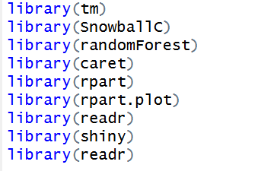
Installing & loading packages:
.
tm → Text mining (corpus, cleaning text)
SnowballC → Word stemming (reducing words to root form)
randomForest → Random Forest classification model
caret → Data splitting and evaluation
rpart → Decision Tree model
rpart.plot → Visualize decision trees
readr → Read CSV files
shiny → Build interactive web app

Slide 4


2. Reading and Exploring Dataset
Reads the CSV file into R
View() opens the dataset like Excel
head() → first 6 rows
dim() → number of rows & columns
summary() → overview of data

Slide 5

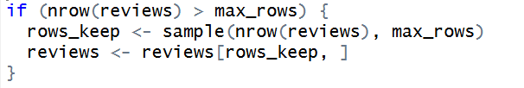
Selecting Required Columns
Keeps only Review, Summary, and Sentiment
Removes unnecessary columns.
4. Reduce data size (to avoid slow system)
set.seed() → ensures same random result every time
Limits data to 8000 rows to reduce computation time
Randomly selects 8000 rows if dataset is larger

Slide 6
5. Combining Review and Summary Text
Merges Review + Summary into one text column
Improves sentiment understanding
Keeps only final text and sentiment label
6. Removing Missing Values
Deletes rows with missing text or sentiment

Slide 7
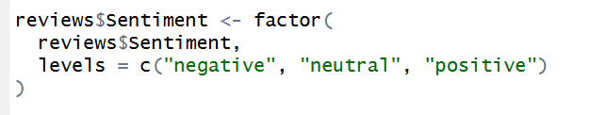
7. Converting Sentiment into Factor
Converts sentiment into categorical variable
Sets proper order for classification
8. Creating Text Corpus
Converts text into a corpus
Corpus = collection of documents

Slide 8

9. Text Pre-processing (Cleaning)
Converts text to lowercase
Removes numbers
Removes punctuation marks
Removes common words like the, is, and
Removes extra spaces

Slide 9
Reduces words to root form
(e.g. liked → like)
10. Creating Document Term Matrix (DTM)
Converts text into numerical form
Rows = documents, Columns = words
Removes very rare words
Keeps only useful terms

Slide 10
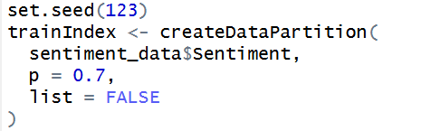
11. Preparing Final Dataset
Converts DTM into a data frame
Adds sentiment column to features
12. Train-Test Split (70-30)
Splits data while maintaining class balance
70% training data (to build the model)
30% testing data (to evaluate the model)

Slide 11


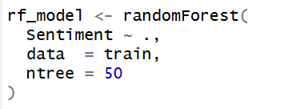
train → training data
test → testing data
Checks class distribution
13.Random Forest Model
Builds Random Forest classifier
ntree = 50 → number of trees

Slide 12
14. Model Prediction & Accuracy
Predicts sentiment for test data
Calculates accuracy
Prints accuracy result
15. Decision Tree Model (Visualization)
Builds a decision tree
Displays decision tree graph

Slide 13

16. Feature Extraction Function for New Text
Stores vocabulary used during training
Function to convert new user text into model-ready format
Inside function:
Same cleaning steps as training
Uses same dictionary
Converts text into numeric features

Slide 14


17. Shiny UI Code
Creates the main layout of the Shiny web application
fluidPage means the page adjusts automatically to screen size
Displays the title at the top of the app
Divides the page into two parts:
Sidebar (left)
Main panel (right)

Slide 15
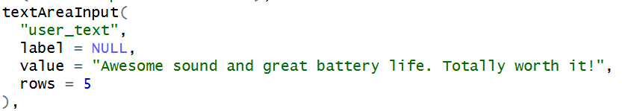
18. Sidebar Panel (User Input Area)
This is the left side of the app
Used for user input and model information
Displays a heading for the input section
Creates a text box where the user can type a review
"user_text" → input ID used in server code
value → default text shown in the box
rows = 5 → height of the text box

Slide 16

Creates a button
When clicked, prediction is triggered
Adds blank space for better layout
Displays model details such as:
training size
test size
accuracy

Slide 17


19. Main Panel (Output Area)
This is the right side of the app
Used to display results
Shows the predicted sentiment of the entered review
Displays a decision tree plot
Helps users understand how sentiment decisions are made

Slide 18
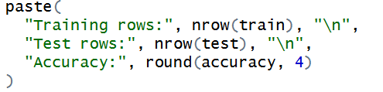
20. Displaying Model Information
Creates output text to show model details in the UI
Displays:
  number of training records
  number of testing records
  model accuracy (rounded)
This information appears in the sidebar panel.

Slide 19

21. Predicting Sentiment on Button Click
Runs code only when the Predict button is clicked
Reads the text entered by the user
Checks if the input is empty
Shows an error message if no text is entered
Converts the user’s text into numerical features
Uses the same preprocessing as training data

Slide 20
Predicts sentiment using the trained Random Forest model
Displays the predicted sentiment in the app
22. Displaying Decision Tree Plot
Creates a plot output in the UI
Displays the decision tree model for explanation purposes

Slide 21
23. Running the Shiny App
Connects UI and server
Launches the Shiny web application

Slide 22
Thank you

